Slide 1
Update on research collaboration
PhD Roberto Chiosa
10 February 2022
PhD Candidate: Roberto Chiosa
Supervisor: Prof. Alfonso Capozzoli
Co-Supervisor: Prof. Cheng Fan

Slide 2
Agenda
Update on matrix profile paper, results and discussion and deadlines
Update on current research activities
Research opportunities to be investigated

Slide 3
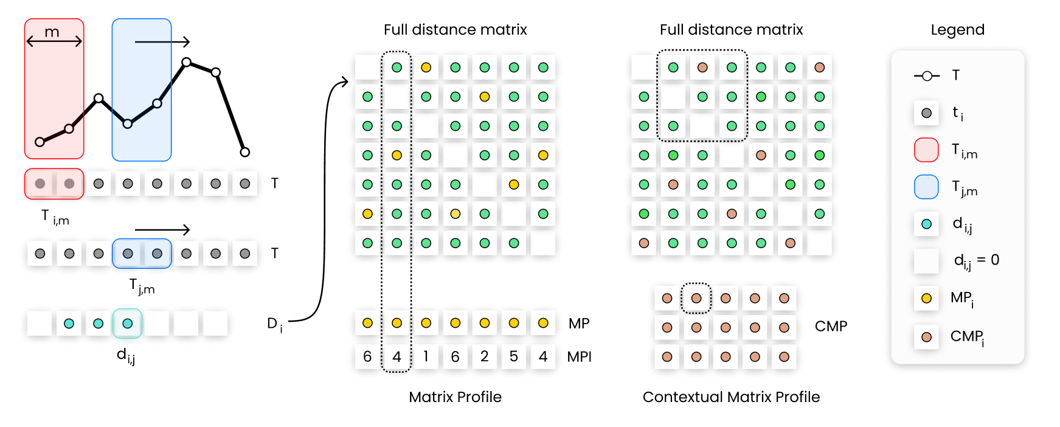
Matrix Profile Paper: Recap
Matrix Profile (MP) performs all-similarity-join-search among two timeseries, i.e. finds the nearest neighbour for each object of a data collection. MP is a one-dimensional timeseries that stores the z-normalized Euclidean distance between each subsequence of the first series and the closest matching subsequence (i.e., nearest neighbour) of the second timeseries
Contextual Matrix Profile (CMP) algorithm permits to define ranges along two timeseries and look for the best matching subsequence among these ranges. This permits different a priori grouping of the timeseries observations so that MP calculation can provide novel and more interesting insights.

Slide 4
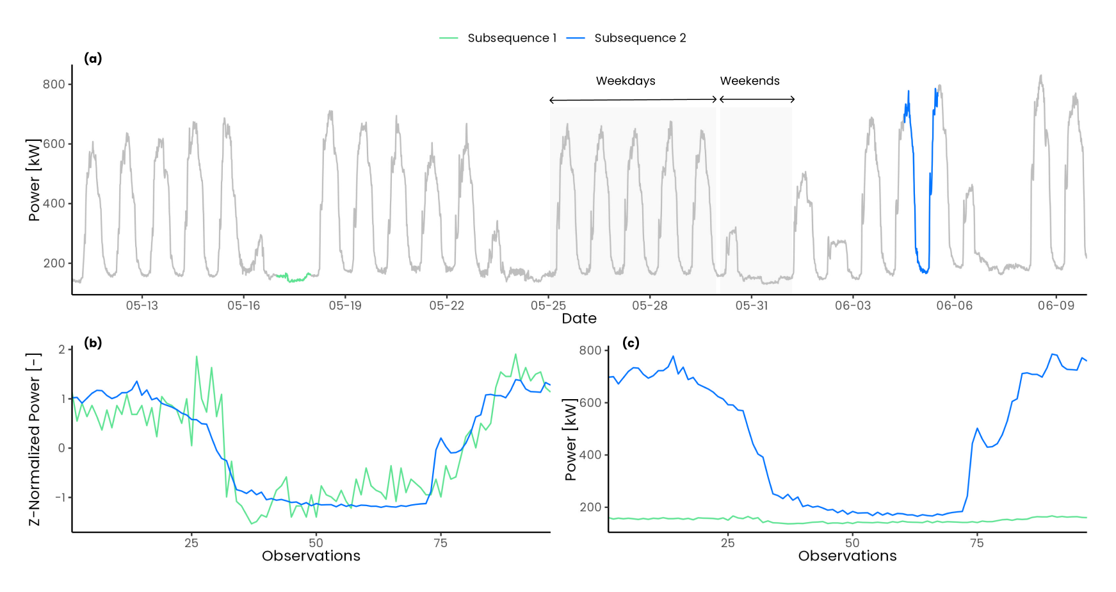
Matrix Profile Paper: Objective
Explore and propose a solution to the challenges that arise from the application of MP as anomaly detection method in the energy field. To overcome the issues of z-score normalization and its implication by using the Euclidean distance between not normalized subsequences and introducing, thanks to the CMP method, domain specific boundary conditions upstream the MP calculation allowing a fairer comparison between subsequences

Slide 5
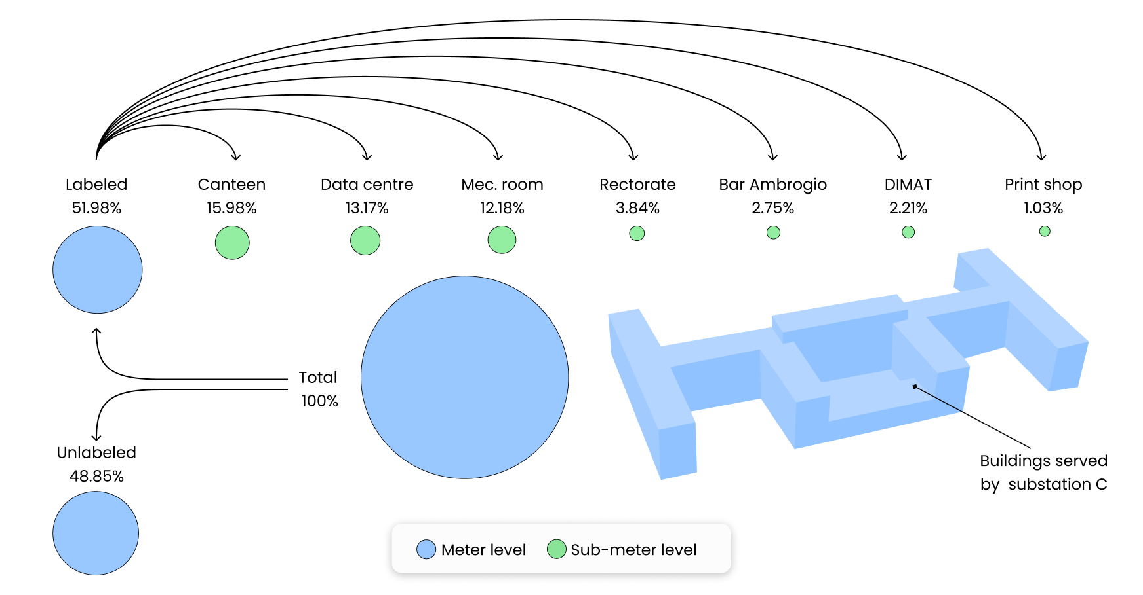
Case study

Slide 6
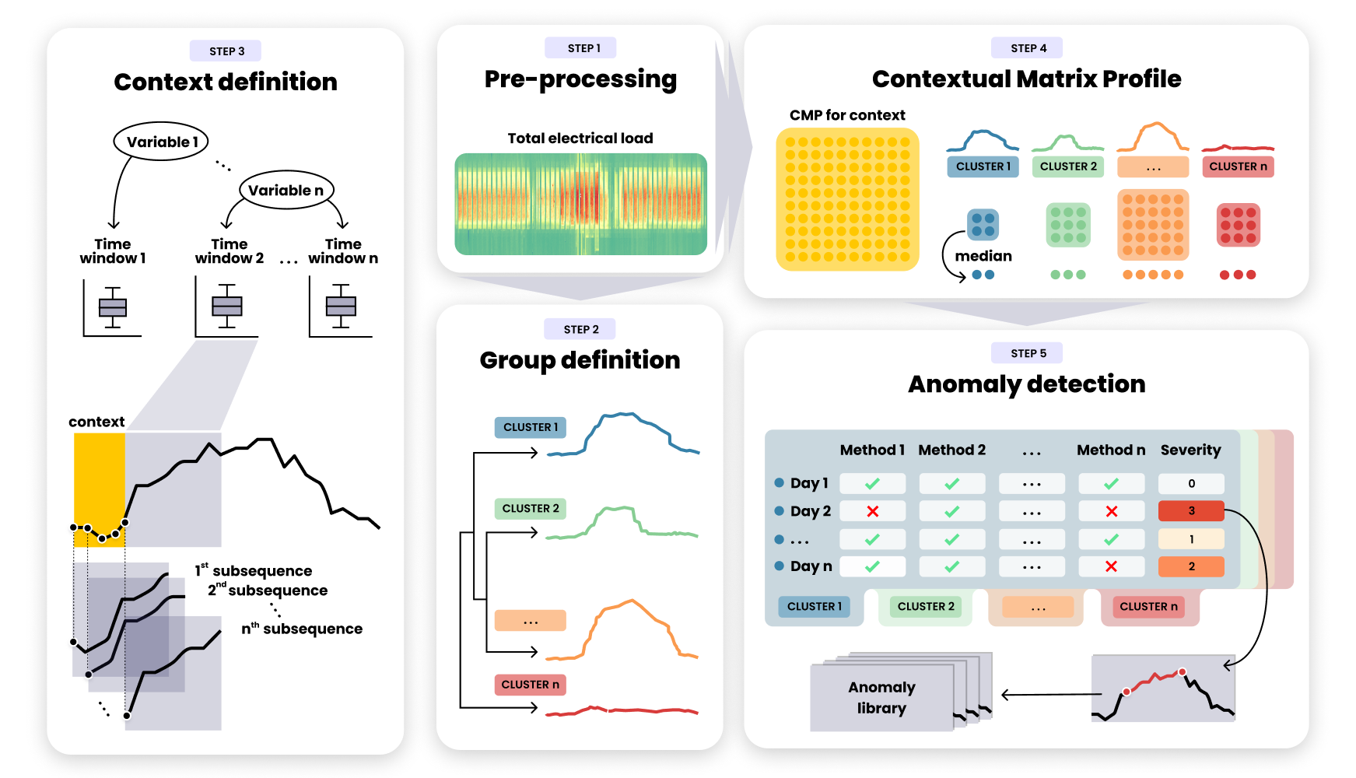
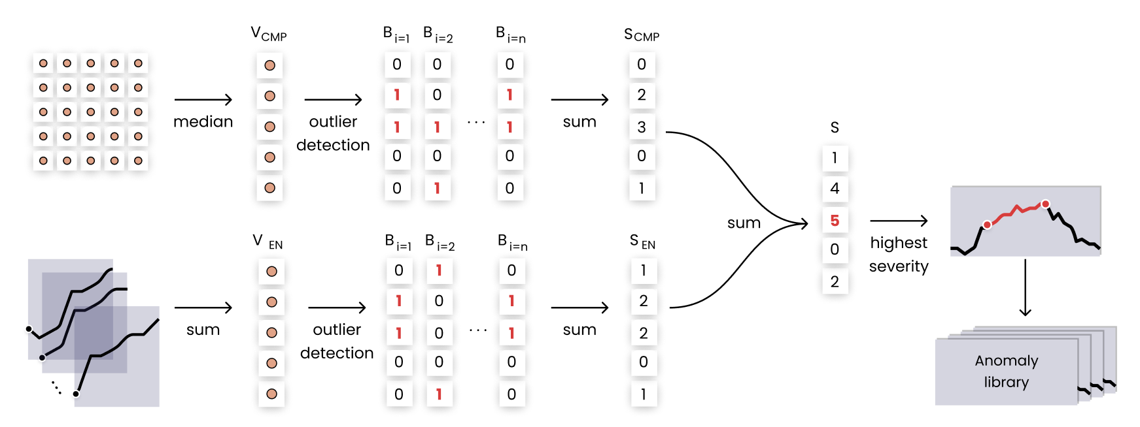
Matrix Profile Paper: Methodology

Slide 7
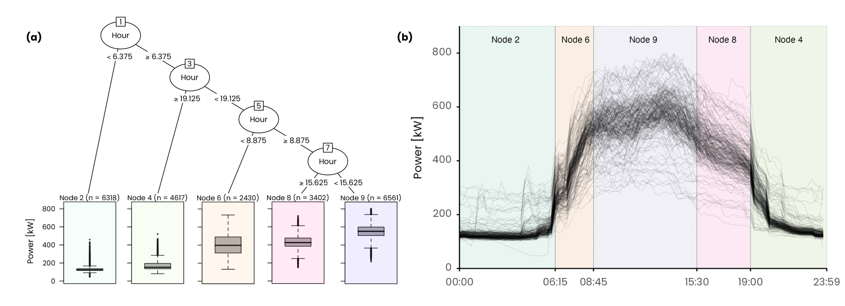
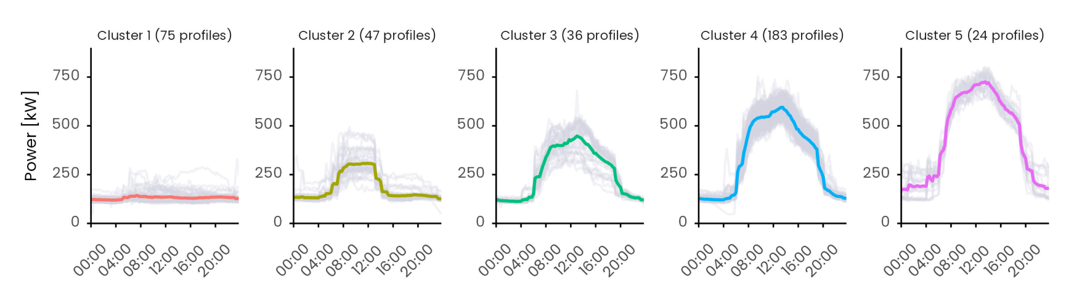
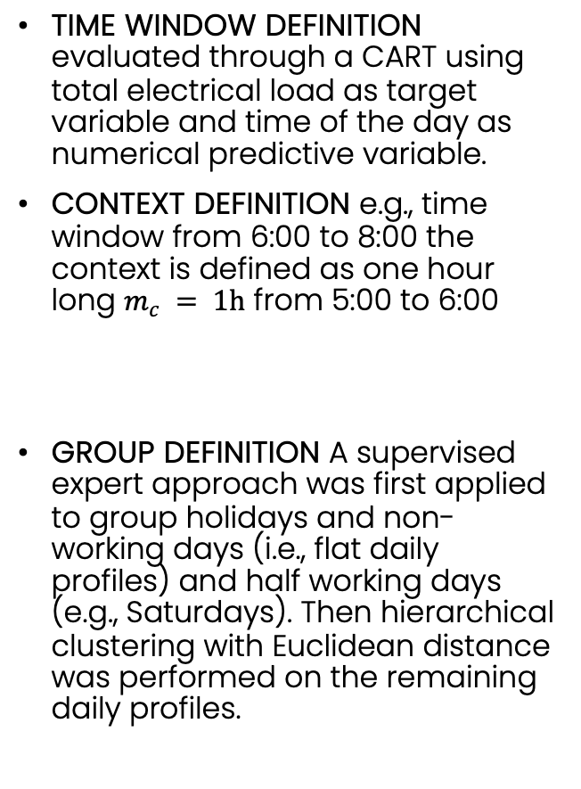
Matrix Profile Paper: Unsupervised parameters definition
TIME WINDOW DEFINITION evaluated through a CART using total electrical load as target variable and time of the day as numerical predictive variable.
CONTEXT DEFINITION e.g., time window from 6:00 to 8:00 the context is defined as one hour long $m_{c} = 1h$ from 5:00 to 6:00
GROUP DEFINITION A supervised expert approach was first applied to group holidays and non-working days (i.e., flat daily profiles) and half working days (e.g., Saturdays). Then hierarchical clustering with Euclidean distance was performed on the remaining daily profiles.

Slide 8
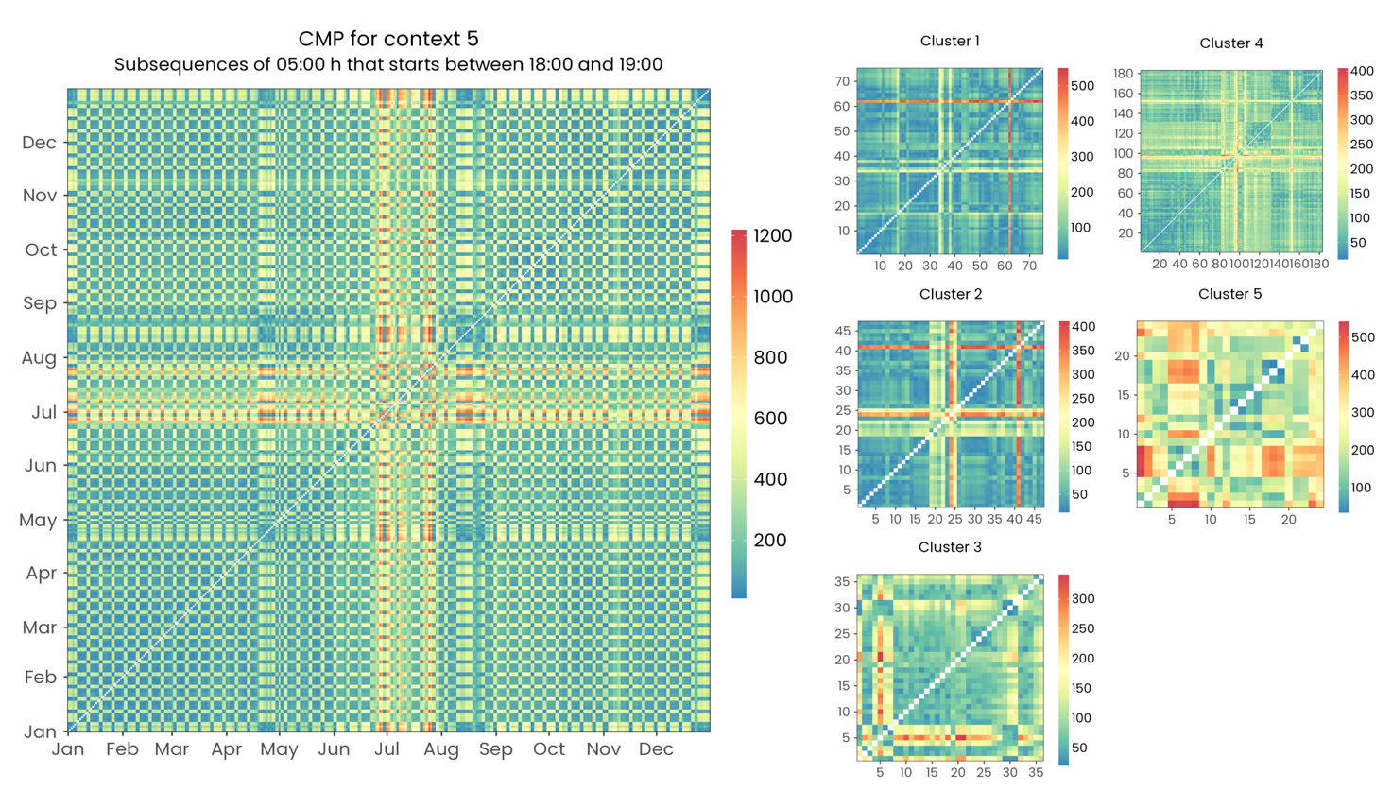
Matrix Profile Paper: CMP calculation context 5
Each point of the matrix shows the Euclidean distance between the best matching subsequences of the two days. Lower the distance better the match. On the right the CMP divided into clusters.

Slide 9
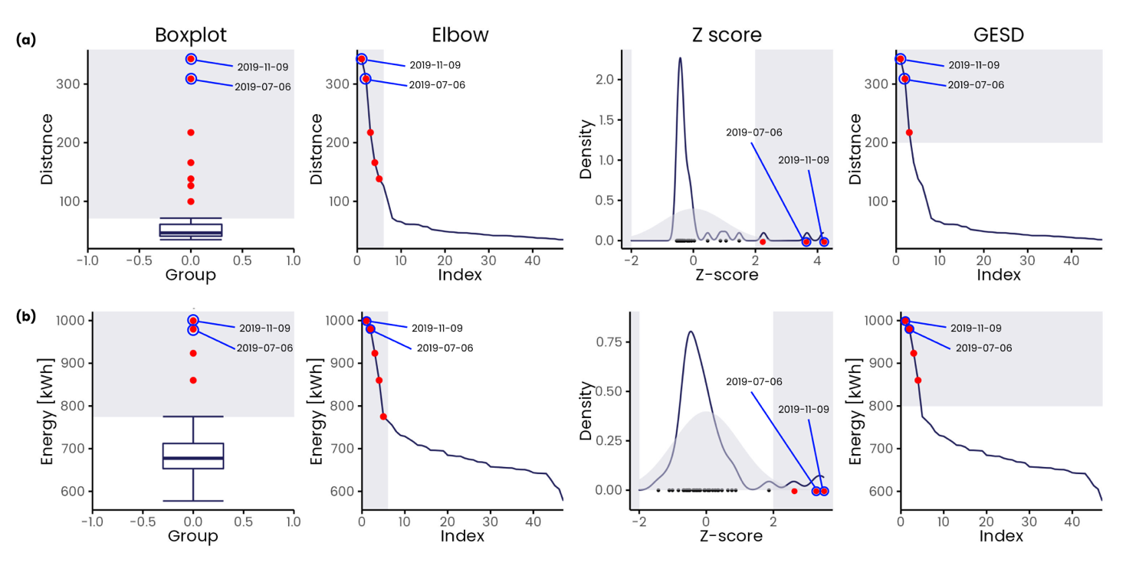
Matrix Profile Paper: Anomaly detection cluster 2 context 5

Slide 10
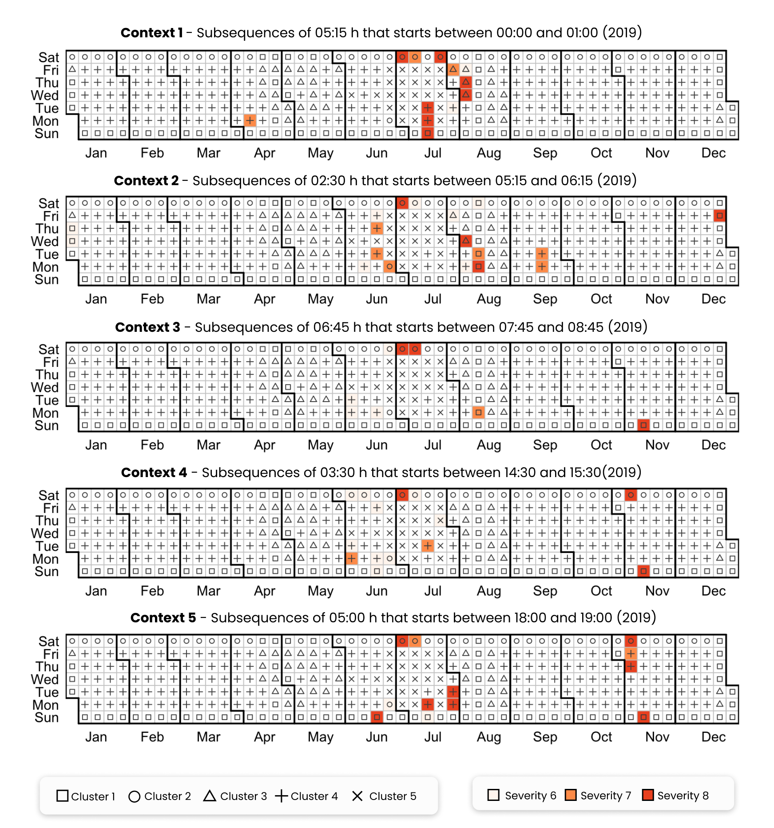
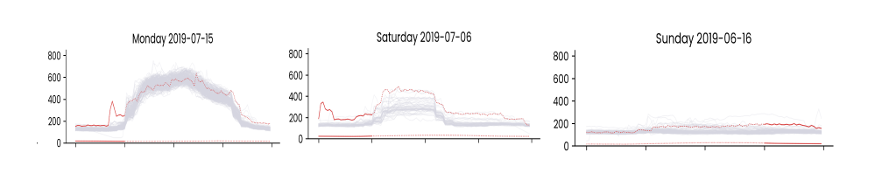
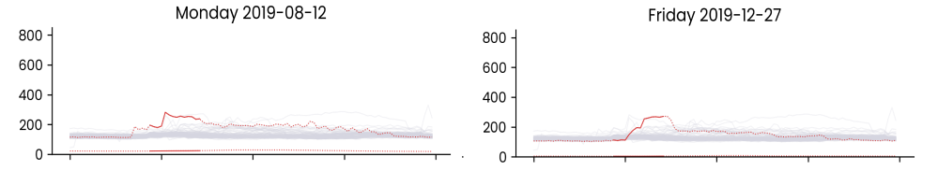
Matrix Profile Paper: Detection results

Slide 11
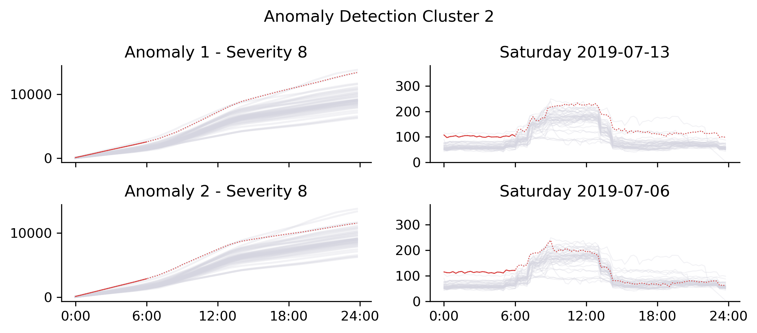
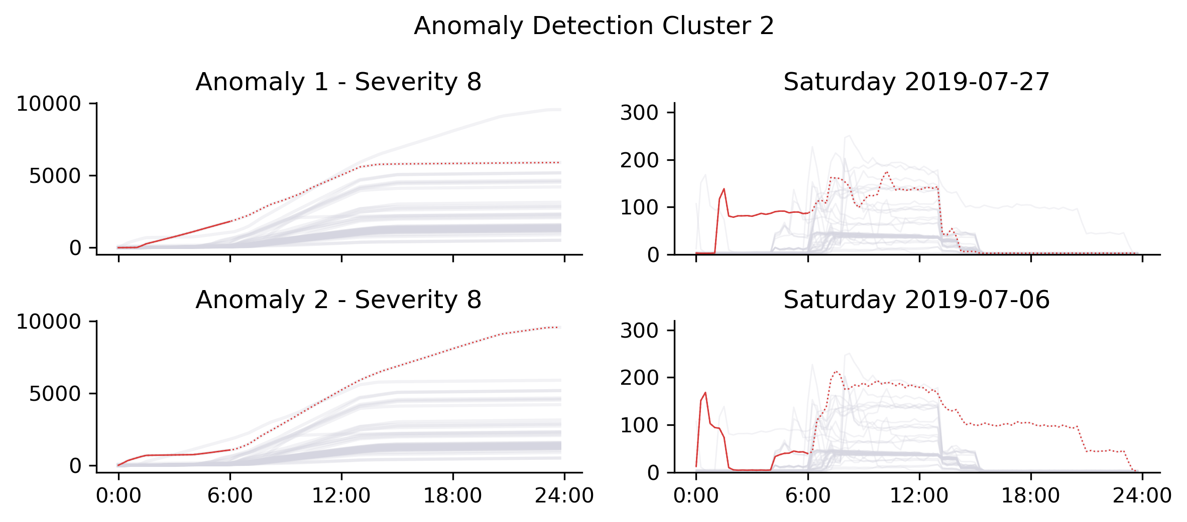
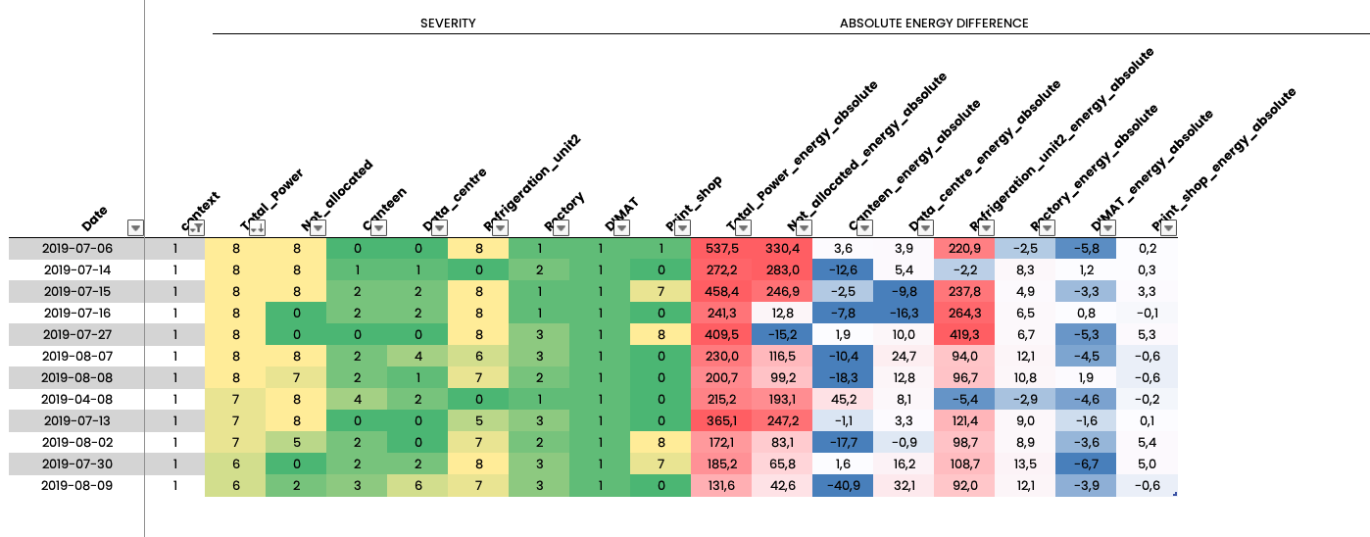
Matrix Profile Paper: Diagnosis results (sub-meter level)

Slide 12
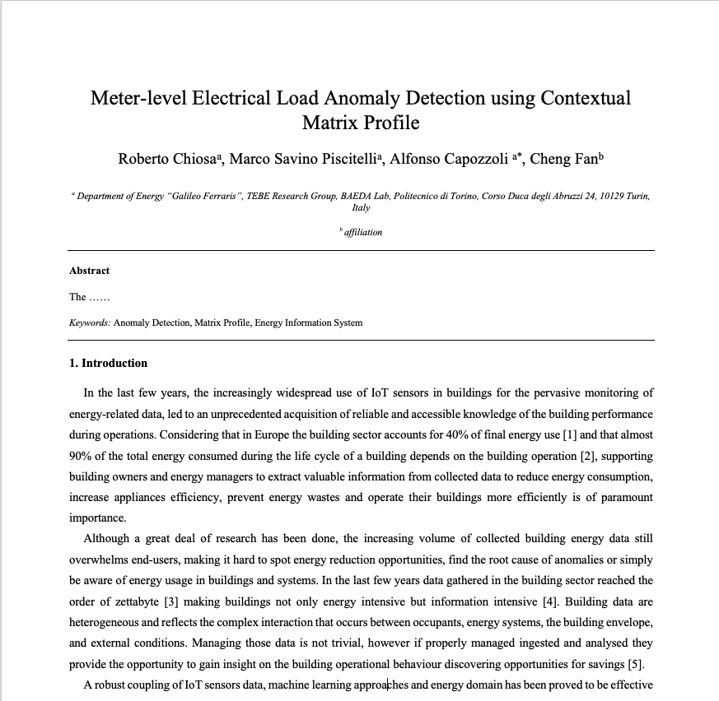
Next steps
We are finalizing the diagnosis results and the discussion section
In few days we will share the draft of the paper for an internal revision process
expected submission -> March

Slide 13
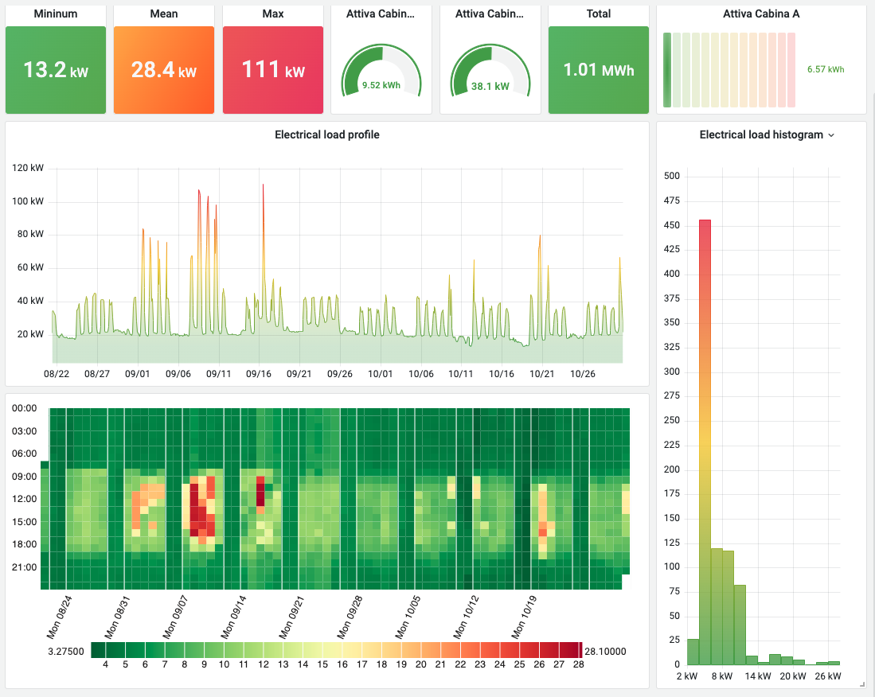
Online implementation of ADD through cloud services
We are working on cloud based infrastructure to deploy online different services (starting from ADD) on real world case studies (POLITO)
We are developing effective KPIs to communicate with end users of these kind of tools (energy manager)
We are participating Annex 81 subtask C1 aimed to develop benchmarking algorithms and standardized KPIs

Slide 14
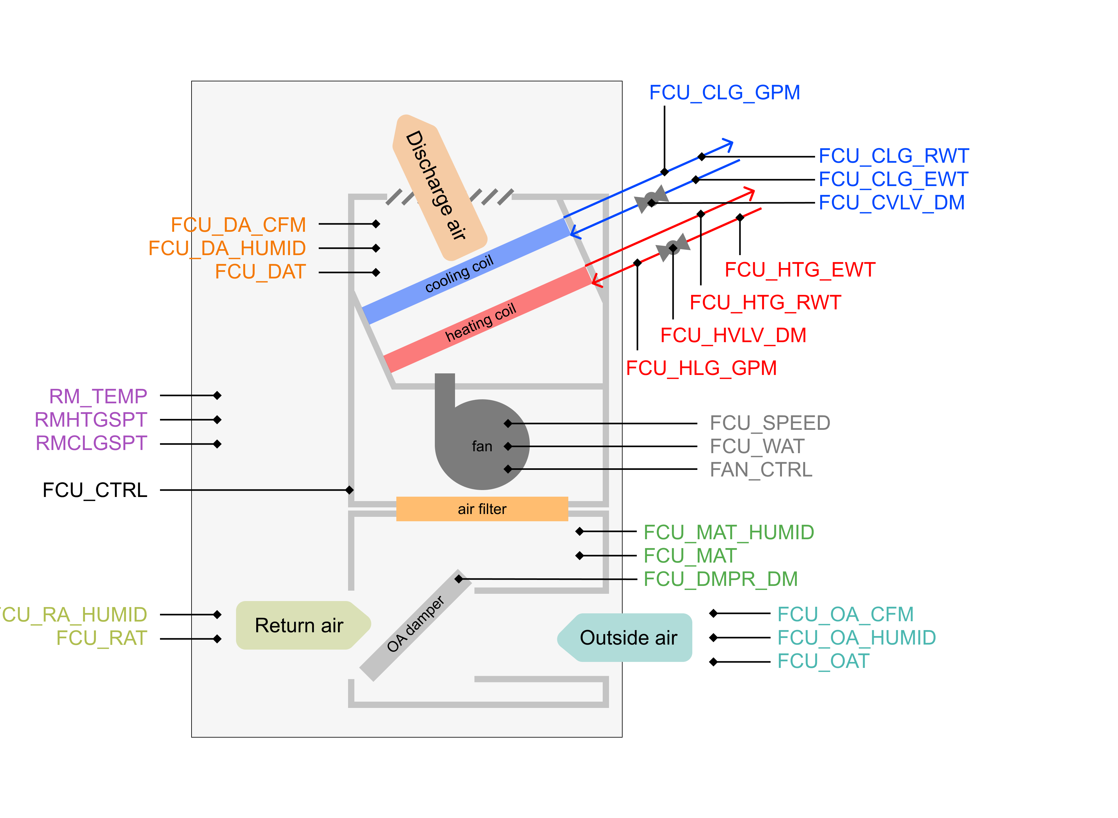
FDD on HVAC systems – The Berkeley datasests
In the framework of Annex 81 subtask c2 we The fan coil unit FCU dataset
testing datasets referring to a fan coil unit generated by Drexel university using HVACSIM+ modeling. The dataset is provided in a set of 49 csv files
Each .csv file represents one-year data with 1-minute measurement frequency (so the data sets can be converted into input samples of any time horizon larger than 1 minute).
Applied rule-based detection to identify faults on equipment
Once datasets will be publicly distributed there is a huge opportunity to collaborate in analysing HVAC datasets

Slide 15
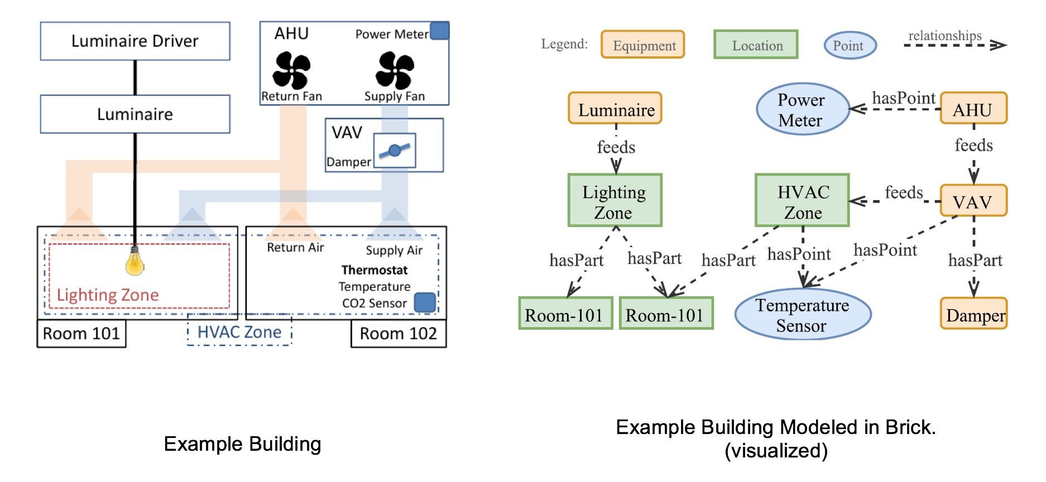
Future steps
Implementation of BRIKS ontology from system level (AHU) to building level on different case studies (POLITO, experimental AHU, Berkeley datasets)
Creation of scalable ADD/FDD methods on these case studies
Test the transferability of FDD algorithms through ontology mapped energy systems
Special issue
…

